Slide 1
California water fix South Delta Water Agency Parties Case-In-Chief Part 1b
TESTIMONY OF TOM BURKE, M.S. P.E.
Notes:
Good Morning Chair Duduc and Hearing Panel Members.
State Name
Representing the “Delta Agencies”, assisting them in evaluating the potential impacts from the CWF
Experience:
I have an MS in Civil Eng with a specialty in Water Resources Eng.
I am a licensed Civil Engineer in the state of California.
I have over 35 years experience performing hydraulic and hydrologic analyses
In my work I have evaluated over 100 different river systems across the country
That experience has been with the Corps of Engineers as a hydraulic engineer
Several different environmental engineering firms
and for the last 17 years running my own water resources engineering firm, Hydrologic Systems
The last 25 years has been in California, working on rivers throughout the state, including tributaries to the Delta, and channel systems within the Delta

Slide 2
Central and South Delta Issues
The Central and Southern Delta
An Existing Stressed System
Existing Stressors
Water Quality
Temperature
Stage
Algal Blooms
Notes:
As stated – hired to assist the Delta Agencies in assessing the potential impacts from CWF to the Central and Southern Delta
As a bit of Background
The Central and southern Delta is presently a very stressed system.
Ag and Munic water users are constantly attempting to combat a variety of issues
Water Quality – primarily salinity
Water Temp – which is one of the primary factors in Algal growth
Water Stage – which effects the ability of diverters to remove water from the delta channels
Its because of the existing water quality issues, and the already stressed and degraded condition, that the Delta Agencies are very concerned that the CWF project can take an already problametic system and make it worse.

Slide 3
Analysis
Evaluated the Impact of the CWF on the hydrodynamics and water quality in the Central and South Delta
Effect on Salinity
Effect on River Stage
Effect on Residence Time
Notes:
In order to evaluate the impacts that may be generated by the Project, I looked at the hydrodynamics and flow conditions through the Delta for each of the Water Fix Scenarios.
The DSM 2 hydrodynamic model for the Delta was used model the flow conditions of the WaterFix Scenarios.
The flow conditions for the 4 proposed scenarios were modeled by using the model scenarios that were uploaded by the petitioners to the Board Hearing site.
In this analysis I evaluated the changes in flow patterns into, through, and out of the Delta for each of the proposed WaterFix Scenarios,
and along with the changes to the hydrodynamics in the Delta, we evaluated the changes in Salinity, River Stage and Residence Time that would be generated by those changes in flow into, through, and out of the Delta.
The changes were evaluated by comparing the waterfix scenarios to the No Action Alternative that has been proposed by the petitioners.

Slide 4
CWF System Components
Diversions
Tunnels
4 Scenarios
B1
H3
H4
B2
NAA
Notes:
The CWF project consists of several different components
There will be three new diversions placed along the Sacramento River at the North end of the Delta. These diversion points will discharge into an intermediate forebay downstream of the diversions.
From the forebay, the diverted water will be conveyed through 2- 42’ Dia parallel tunnels roughly 9 miles to the enhanced Clifton Court Forebay.
The petitioneers are proposing 4 scenarios to encompass the potential operations of the project, and a No Action Alternative to represent the Delta without the project in place.
The scenarios represent a range of operations that have been characterized by the petitioners as ranging from a low delta export boundary B1 to a high Delta Export Boundary B2. The scenarios H3 and H4 represent intermediate conditions between those two Delta Export Boundaries.
It should be noted that the two boundaries, which represent the Delta Export Extremes, do not necessarily represent the high and low range of Delta Impacts.

Slide 5
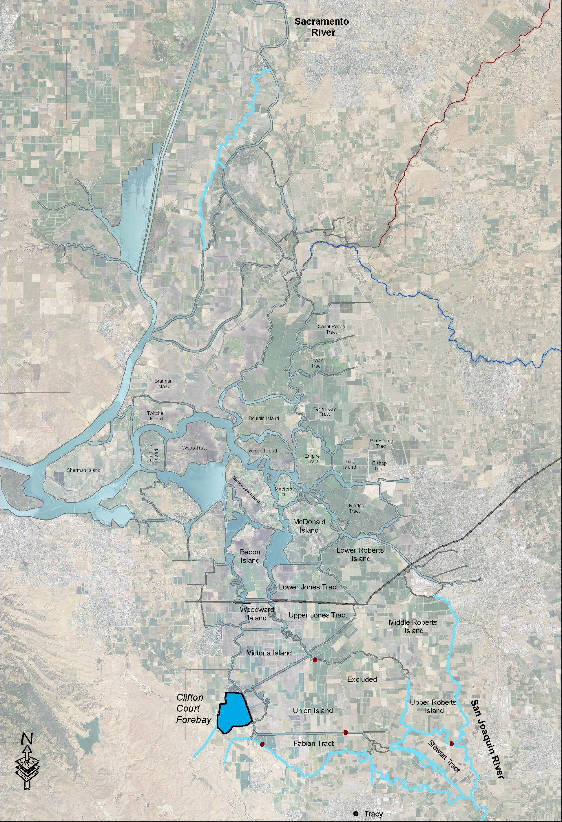
Delta Schematic
Sacramento River
Inflow
Tidal Inflow
and Outflow
Tributary Inflows
San Joaquin River
SWP Exports
CVP Exports
Notes:
I am sure that everyone is familiar with the basic flow components to the Delta, but I thought that it would be helpful to provide a brief overview
This figure represents a plan view of the Delta, which can be seen in the center of the graphic.
The primary Inflow components to the Delta come from the Sacramento Riv, in the north, the San Joaquin River in the south, and miscellaneous tributaries that flow into the Delta from the west. These components are generally of high quality, lower temperature, and lower salinity than what is in the Delta.
There is also water that enters the Delta from the west that is driven into the Delta from an incoming tide. The Delta see’s an incoming and outgoing tide roughly twice a day. This incoming tidal water is generally higher in salinity than what is found in the Delta.
It should be noted that the water that leaves the Delta in an outgoing tide is not necessarily lost. Much of that water flows back into the Delta in the next incoming tide.
At the southern end of the Delta are the existing CVP exports from Old River and the SWP exports from Clifton Court Forebay.
There are other miscellaneous exports from the Delta, such as the North Bay Aqueduct, and the Contra Costa Canal, that also add to the total exports from the Delta.

Slide 6
Delta Schematic
Sacramento River
Inflow
In Delta Mixing
Tidal Inflow
and Outflow
Tributary Inflows
San Joaquin River
SWP Exports
CVP Exports
Notes:
All of the inflows and outflows from the Delta result in the Delta becoming a Giant mixing pot of fresh and saline water entering and leaving the system.
The relative volume of the different components and the resulting flow through the Delta has a direct impact on the water quality of the Delta
Independent of any modeling, a simple mass balance of the Delta would show you that a change in any one of these components will have an effect on the resulting water quality.

Slide 7
CFW Schematic
Notes:
This figure is a map showing the layout of the CFW components.
You can see the location of the 3 diversion points at the north end of the Delta.
The roughly 9 mile 42’ twin tunnels
And The enlarged Clifton Court Forebay.
The end result of this system is the diversion of Low Salinity, Low Temperature, clean Sacramento River water around rather than through the Delta.

Slide 8
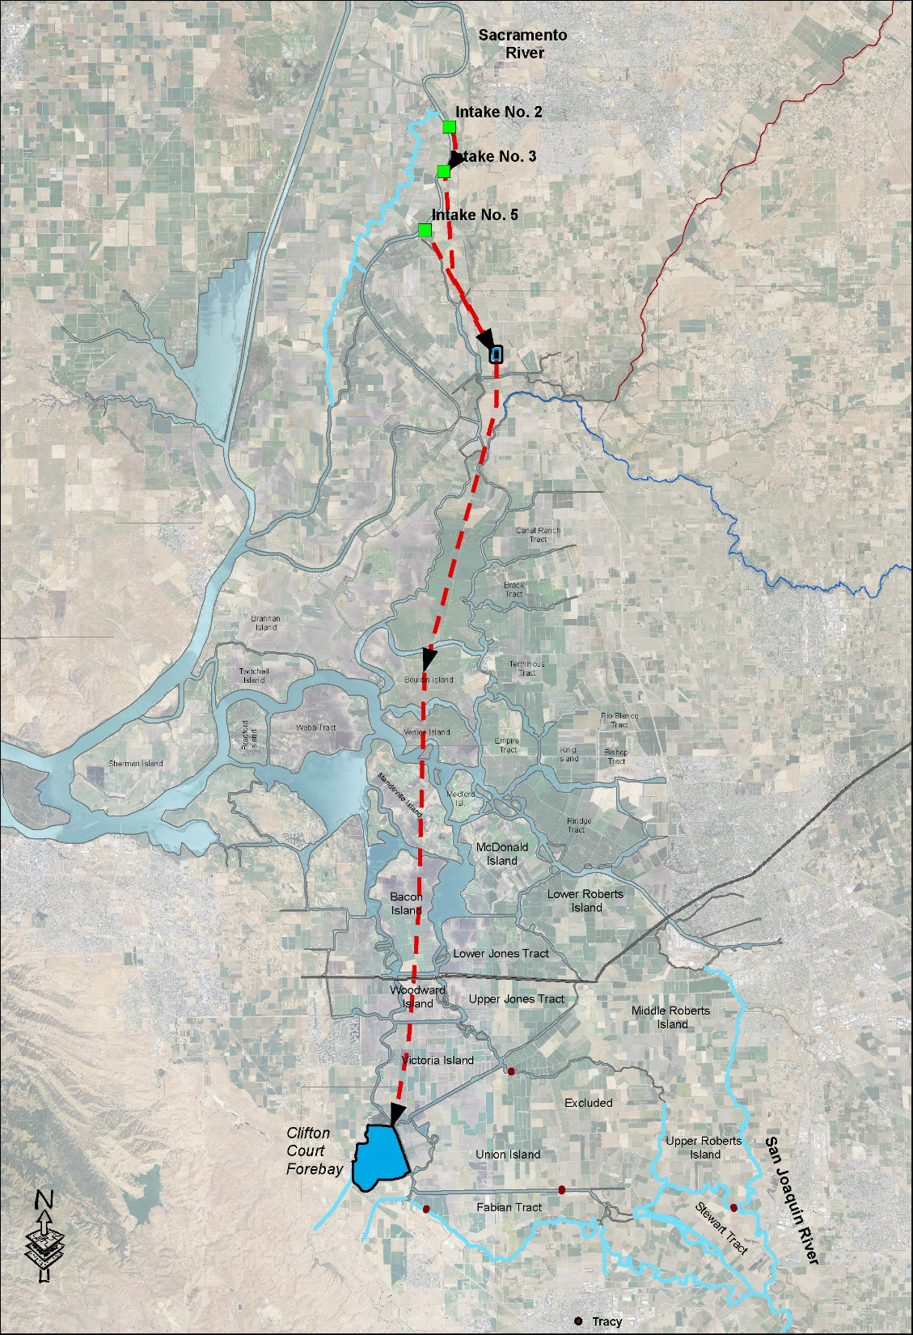
CFW Schematic
Sacramento River
Inflow
Reduced
Sacramento River
Inflow
Tidal Inflow
and Outflow
Sacramento Bypass Flows
Tributary
Inflows
Reduced Delta Mixing
San Joaquin River
SWP Exports
CVP Exports
Notes:
With all other components being roughly equal, the end result is much less fresh water to mix with the existing water in the Delta.
The resulting question is,
Will the removal of this much fresh water from the Delta
have any effect on Delta water quality?

Slide 9
Approach To Analyzing Reduced Sacramento Inflows
Use Existing Models
Set NAA at the Baseline
Evaluate on a 15-minute and Daily Timeframe
Notes:
To try and answer that question, I wanted to model the actual water movement through the Delta and determine if removing fresh water from the system will impact water quality
We used the existing DSM 2 models that were uploaded by the petitioners to evaluate the impact of each of the scenarios as compared to the No Action Alternative.
DSM 2 is a 1-dimensional unsteady flow model that can evaluate flow and water quality characteristics of that flow into, through, and out of the Delta.
It is not a perfect model, and has been brought up previously in the hearing, no model is perfect.
It has been in use in the Delta for many years and has gone through multiple revisions and improvements to try and get it to model the Delta.
It works fairly well for modeling water movement in most areas of the Delta, but can be problematic for modeling water quality characteristics in some areas.
It computed water movement through the Delta on a 15-minute time step, providing for high resolution of flow changes over time within the Delta.

Slide 10
Modeling Timeframe
CALSIM II
82 Years
DSM2
16 Years
Hydrologic Similarity Between Time Periods
Notes:
The input to the DSM 2 model is generated from the CALSIM II model
CALSIM II is a reservoir operations model that simulates inflow, outflow, and operations of the State and Federal projects. It is basically a water accounting model, run on a monthly time step, that is incapable of evaluating water flow or water quality within the Delta.
That is where the DSM 2 model comes into play. CALSIM II provides the flow input to the DSM II model. The DSM 2 model then performs the hydrodynamic analysis to determine flow and water quality within the Delta.
For the CWF project, the more accurate hydrodynamic model DSM II was run for a 16 year time period, whereas the CALSIM II model was run over an 82 year period of record.
From a statistical viewpoint, the longer period of record you have, the more confidence you will have for your projections of high and low flow periods and exceedance analyses.
Since the Petitioners has developed exceedance analyses on using the shorter 16 year period, a comparison was conducted to determine if is valid to use the 16 year period rather than the longer 82 year period.

Slide 11
Probability Comparison
Notes:
To compare these two periods are, we developed a probability analysis of the flow into the Delta using the 8-River index.
Data for this annual index is readily available form DWR. This index goes back to 1922, so it will allow us to compare the 1922-2003 period to the 1976- 1991 period.
This is a plot comparing probability of occurance of flow for the 8-river index for the shorter and longer time periods.
X Axis
Y Axis
As you can see, the two plots follow a similar trend, but provide very different values of flow.
For Example, for the 90% exceedance flow, the shorter exceedance developed from the 16-year period is 47 MAF, but from the probability distribution developed from the longer 82 year period, the 90% exceedance flow is only 39 MAF. That is an 8 MAF difference, almost twice the full volume of Lake Shasta, and represents a 21% error in prediction.

Slide 12
Difference in Exceedance Predictions
% Exceedance | Water Year 1922 - 2003 | Water Year 1976 - 1991 | % Difference
10 | 11.27 | 8.97 | 20.4%
20 | 13.96 | 11.47 | 17.9%
30 | 15.71 | 11.71 | 25.5%
40 | 18.67 | 13.8 | 26.1%
50 | 21.31 | 16.51 | 22.5%
60 | 24.73 | 20.61 | 16.7%
70 | 29.26 | 31.57 | -7.9%
80 | 33 | 34.63 | -4.9%
90 | 38.91 | 47.18 | -21.3%
95 | 42.88 | 52.69 | -22.9%
Notes:
This table provides the flow estimates developed from both flow records, and the percent difference between them.
It is a rule of thumb in statistics that the larger the dataset for making a statistical analysis, the lower your error will be. As we can see here, using 16 years rather than the full 82 years, generates a substantial amount of error.
Given this large of a difference, I have some serious question concerning the accuracy of exceedance predictions based on the shorter period of record.

Slide 13
Difference in Exceedance Predictions
Notes:
This is another plot of the error of flow estimate between the two time periods.
X Axis
Y Axis
Describe Plot
Given that the 82-year run of the CALSIM II model provided the data DSM2 model need to run, I don't understand why the limited 16 year period was used instead.

Slide 14
Selection of Analysis Points
South Delta
Central Delta
Distribution and Problem Areas
Notes:
The petitioners model was used to evaluate water quality and flow at 17 different locations in the Central and South Delta
The sited were distributed over the two areas to identify changes in flow and water quality in those areas that have typically had problems.

Slide 15
Detailed Analysis Points - 1
Notes:
South Delta Locations
Orient Map, San Joaquin, Old River, Middle River, Grant Line Canal
Further to the south on the right side of the map is Vernalis
Further to the west off of the left side of the map is the Clifton Court Forebay.

Slide 16
Detailed Analysis Points - 2
Notes:
Central Delta Locations
Orient Map, Old River, Middle River, Discovery Bay

Slide 17
Detailed Analysis Points - 3
Notes:
North Delta Location
Orient Map, Sacramento River, San Joaquin River

Slide 18
Differences in Approach To Impact Analysis
Timescale of Importance
Averaging
Notes:
The hydrodynamic and water quality analysis was conducted using the Petitioners models on a 15-minute time step.
The model results for both the 15-minute and daily average were evaluated.
This differs from the Petitioners analysis, where typically the monthly value, averaged over all 16 years of the DSM2 model run was used as an indication of impact.
This type of averaging used by the petitioners, tends to eliminate the high and low values of the parameter that you are evaluating.
Given the dependence of irrigation on the quality of water when it is applied, I felt that an average over multiple years would not accurately reflect the impact of any water quality change.
The following two plots illustrate this difference.

Slide 19
Monthly Average EC Old River at Tracy Road
Notes:
This is a plot from Exhibit DWR-513.
It shows the monthly average EC change at the Old River at Tracy Gage for each of the waterfix scenarios and the NAA.
As can be seen in the plot, except for March, April, and May, there is very little difference in the EC (Salinity) estimate. Based on the graph, an average difference in EC is less than 20 uS/cm. Remember this number, we want to make an important comparison,
It is important to note how these numbers were calculated.
Take October for example, an average EC was computed for October of each of the 16 years, which includes both high water years and low water years. Then all of those 16 October values are averaged together, so you get on EC estimate for October that essentially represents the long term average.
To a water user in the Delta, that long term average is useless, when they need to divert tomorrow.

Slide 20
Difference between Mean Daily CWF and NAA Site: SDN1, Old River at Tracy
Notes:
Here is a plot of the difference between the CWF scenario B1 and B2 and the NAA.
X Axis
Y Axis
For each of the two scenarios the difference between daily value of waterfix scenario was subtracted from the NAA.
As can be seen in the graph, the change in EC for scenario B1 can sometimes be over 600 uS/sm, somewhat more than the 20 uS/cm long term average that was seen in DWR-513.
These increased salinity values for the CWF scenarios sometimes last for weeks or months.
It should be noted, that we are using the Petitioners DSM2 uploaded models to produce this plot. No modifications have been made to the models.

Slide 21
Average Annual Salinity for CWF Scenarios As Compared to the NAA Site: SDN1, Old River at Tracy
Notes:
This is a plot of looking at the salinity data averaged over a whole year.
X Axis
Y Axis
Description
You can see the increase in salinity due to the CWF models is still present, even when averaged over the summer and winter period for each year.
But it should be noted that looking at this average, the difference in salinity between the CWF scenarios and the NAA is greatly reduced, and an extended period where high salinities may have impacted water users, is now averaged out of the plot.

Slide 22
Percent of Time the Daily Average EC of the WaterFix Scenarios Exceeds the EC of the NAA Site: SDN1, Old River at Tracy
Notes:
To further evaluate the extent of increased EC for the waterfix scenarios, I compared the daily average EC for each water fix scenario to the NAA, over the full 16 year period of the DSM2 model run.
From that comparison, I made a simple calculation of how often each waterfix scenario had a higher EC than the NAA.
I calculated the percent of time the waterfix scenario was greater than the NAA for three time periods, for all 16 years, and two dry periods, April – Sept 1991, and April – Sept 1977.
Basically for all three time periods, the CWF scenarios resulted in an increase in EC over 50 % of the time.
The worst case was for the April – Sept 1977 period, where the WaterFix scenarios increased salinity between 58% and 92% of the time.
In the best case scenario, the salinities increased between 52% and 64% of the time.

Slide 23
Measured Salinity at Old River at Tracy and Predicted Salinity from the NAA
Notes:
It should be noted that in comparing the DSM2 model results between the NAA and the WaterFix scenarios, that DSM2 itself is under predicting the actual salinity in the South Delta.
X Axis
Y Axis
Describe Plot
This plot shows the DSM2 Prediction of salinity at Old River near Tracy for the 1976-1991 water years. On the same plot, I have plotted the measured salinity at the Old River near Tracy gage.
As can be seen, the DSM2 model consistently under predicts the salinity level at the gage.
So a 100, 400, or 600 uS/cm increase in Salinity is a significant degradation in water quality, and will increase the amount of time that the project is in non-compliance with D-1641.

Slide 24
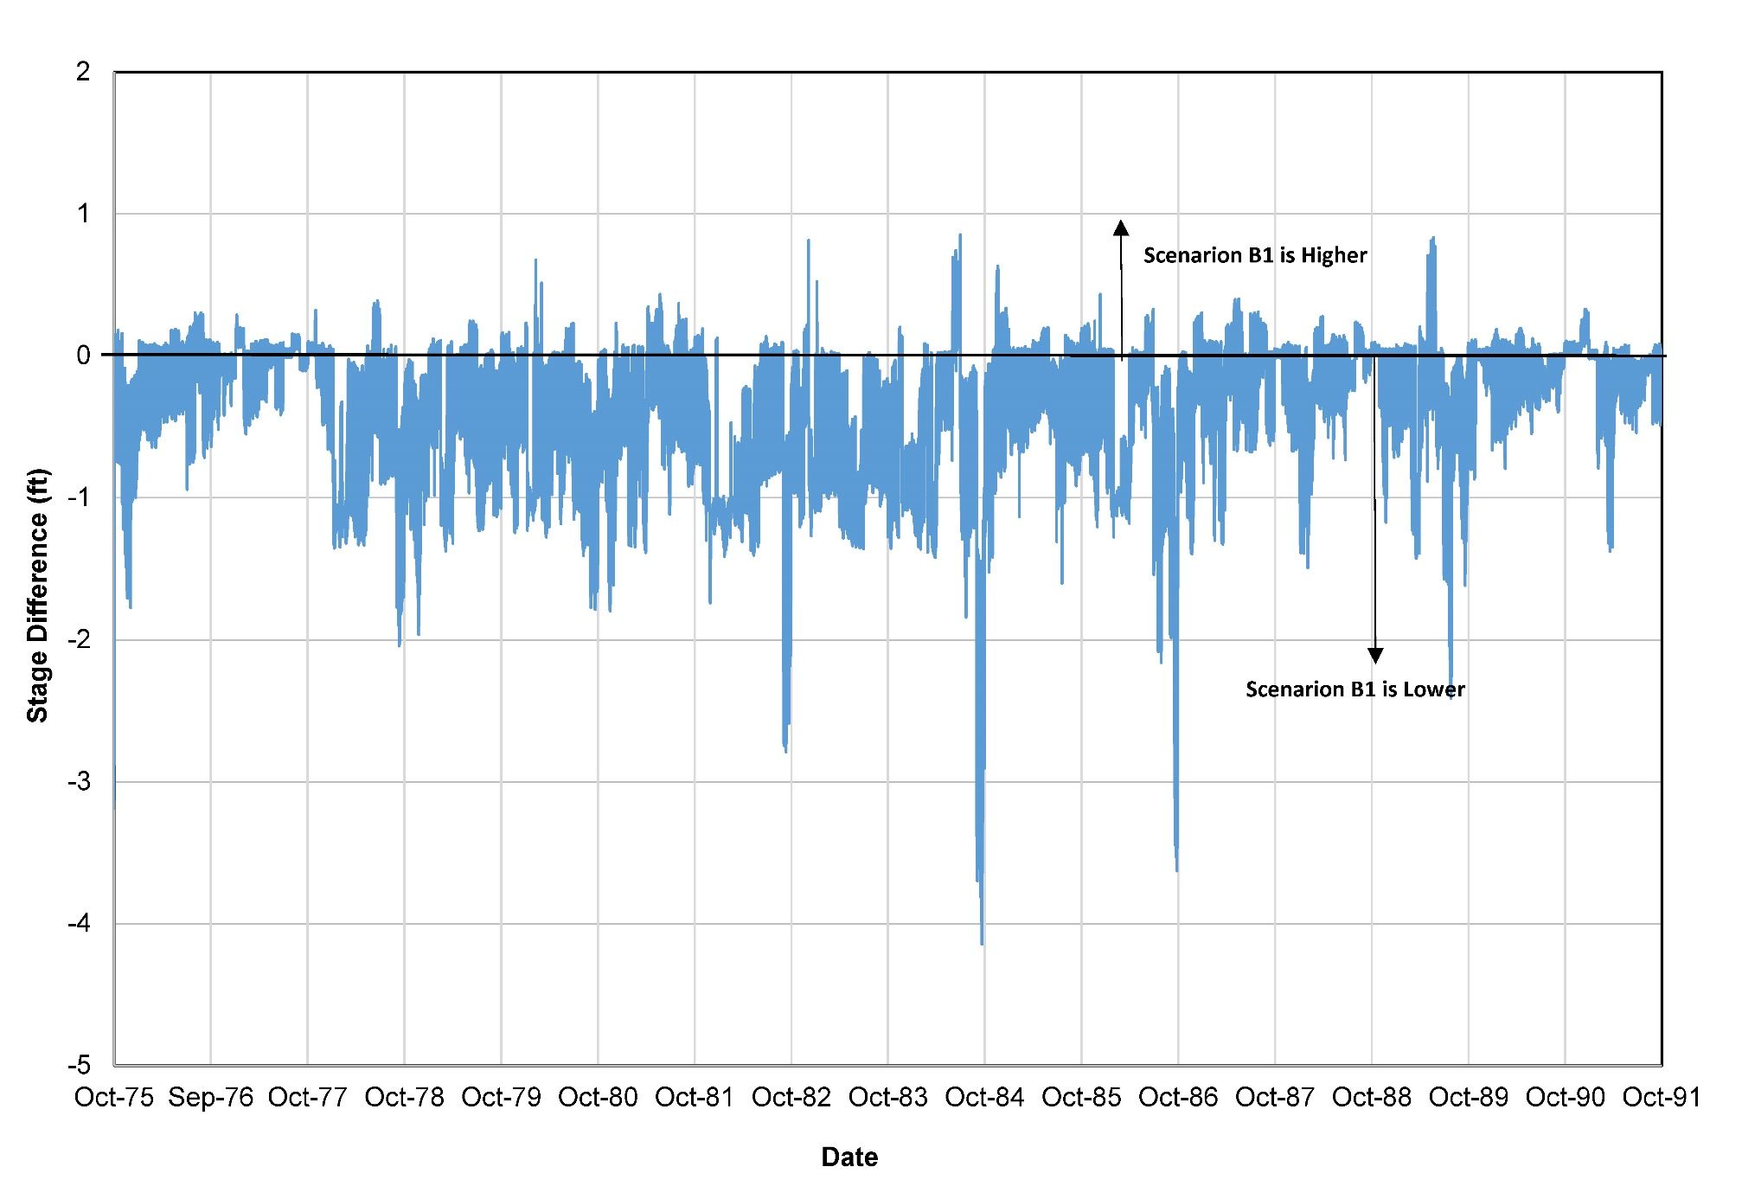
Stage Difference DS of NDD No. 5
Notes:
Another evaluation of the WaterFix scenarios was conducted to determine the effect on the stage in the river downstream of the NDD’s.
The DSM2 model output for WaterFix scenario B1 was compared to the NAA for three locations downstream of the NDD.
A site was selected immediately downstream of the diversion, one 3 miles downstream of the diversion, and a location 9 miles downstream of the diversion.
The 15-minute DSM2 output was averaged so that the high and low tides were averaged together for the day.
Then the Daily stage for the B1 scenario was subtracted from the NAA and plotted up for the 16 year period for the DSM2 run.
This first plot show the change in stage immediately downstream of the NDD. As can be seen, the water level can drop over 4 feet for this scenario. At this location in September of 84, the water level stayed depressed between 2 feet and 4 feet for over 20 days. The drop in water level was often not a short term response to the pumping.

Slide 25
Stage Difference 3 Miles DS of NDD
Notes:
Here is the water level stage change 3 miles downstream from the NDD’s
As you can see, the water level was not lowered as much as immediately downstream of the diversions. The maximum water level decrease went from -4.1 ft. to -3.7 ft.

Slide 26
Stage Difference 9 Miles DS of NDD
Notes:
This plot shows the water level change 9 miles downstream of the NDD’s
At this location, the maximum drawdown went from -4.1 immediately downstream of the diversion to only -2.9 ft. 9 miles downstream of the diversion
It is important to note that the reduction in water level that was presented by the Petitioners was based on averaging the difference over all 16 years, so wet years and dry years are averaged together. Using Petitioners procedure, the average water level drop is only about -0.3 ft.
This type of averaging, used consistently by the Petitioners, masks out the high and low values of the variable that you are looking at.
In the case of river stage, it completely covers up the fact that the water level can be lowered between 2 and 4 feet below the NAA, sometimes for weeks at a time.
That much of a water level drop could impact the intake pipes of water diverters along the river.

Slide 27
Probability of Exceedance For Stage Change Due To The CWF
Notes:
Here is a probability plot that shows the probability of achieving a specific drop in water level for scenario B1 Immediately below the NDD’s
as can be seen in the plot, there is a 90% chance that the river stage drop will be less that 1 ft.,
Which conversely corresponds to a 10% chance that the river stage drop will be greater than 1 ft.
That corresponds to 36 days out of each year the river stage drop will be greater than 1 ft., and 109 days out of each year the water level will be 0.5 ft. lower than the NAA.
The shaded areas in the graph roughly correspond to the amount of time that the river stage will be above or below the NAA. As can be seen by the area shaded red vs the area shaded blue, that the river will spend a lot more time depressed below the NAA than it will spend above the NAA.

Slide 28
Change In Residence Time
Reduction in Flushing Flow For The CWF Scenarios As Compared To The NAA During a Dry Year.¹
Scenario | Middle River | Old River
B1 | -1.5 % | 4.4 %
B2 | -9.5 % | -42.0 %
H3 | -4.3 % | -0.9 %
H4 | -4.5 % | -1.2 %
1. A negative value indicates a reduction in volume moving through the system and a positive value indicates an increase in volume moving through the river.
Notes:
Another analysis of the WaterFix scenarios that was conducted was an evaluation
of the flushing flow moving through Old and Middle Rivers.
The flushing flow has been calculated as the net positive flow moving out of the two rivers over a fixed time period.
The Dry Year 1977 was used for this analysis.
The change in flushing flow for each of the 4 water fix scenarios as compared to the NAA was computed.
The results showed a reduction in flushing flow for all scenarios except B1 in Old River.
B2 has the largest reduction, due to the increased closure of the Old River at Head structure.
This net reduction in flow will have a direct effect on the build up of nutrients in the south Delta and longer residence time will also allow the temperature to increase.

Slide 29
Conclusions
The CWF will result in an Increase in Salinity in the Central and South Delta
Averaging Masks The True Increase
Sometimes High and Sometimes Low, But Generally Results in an Increase 50% of the Time
Notes:
Conclusions
Increase in Salinity
The Averaging used by the Petitioners masks the true increase in salinity.
The salinity will increase over 50% of the time for all waterfix scenarios.

Slide 30
Conclusions (Cont.)
Stage in the Sacramento River Will Decrease DS of the NDD’s
Up to 4’ DS of the Diversion
Up To 3.7 ‘ 3 Miles DS of the Diversion
Up To 2.9’ 9 Miles DS of the Diversion
Notes:
Stage
The project will have an impact on the water level downstream of the diversion points
The calculation of the water level change by the Petitioners, averages in the wet and dry years over the 16 year period, so masks out the true level change.
The lowering of the river stage can stay down for weeks or months through the year. It is not a short term transient phenomena.

Slide 31
Conclusions (Cont.)
Residence Time Will Increase in the Central and South Delta
Notes:
The residence time for water in the Old and Middle rivers will increase over all scenarios except B1 in Old River, where it will have a 4% increase.
The enhanced Old River at Head closure in Scenario B2 will have a dramatic effect on increasing the residence time in Old and Middle Rivers.
Any increase in the residence time will have an adverse effect on the water temperature, and the accumulation of nutrients.
Temperature and nutrient accumulation in the water are two strong driving forces behind algal growth.

